Slide 1
Notes for Organizers and Trainers
READ THIS!
The resources needed and general advice are in the Notes section of the introductory slide – please look!
Details of how to run the day are included in the notes section of each slide
Notes:
History of this course
Autumn 2018. Course initiated by Clare van Hamel, Foundation School Director, Severn Deanery to provide a Deanery based ‘Training the Trainers’ (How to Teach’) course in line with the Foundation Programme curriculum. We are grateful for a grant from Health Education England.
Subsequent history is now on the accompanying document TTT for F2 2020-07-07.docx

Slide 2
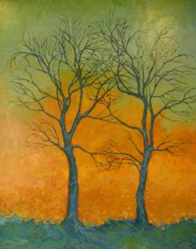
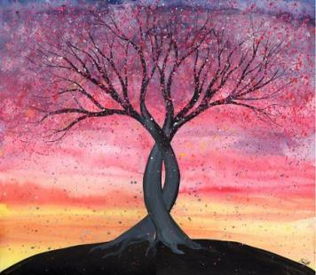
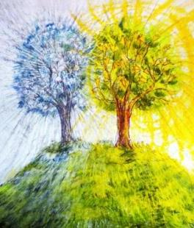

Train the Trainers
How to teach for Foundation doctors
Notes:
Pre-course administration and organisation:
Room booking – adequate size for 24 participants, all day
Catering:
Needs to be booked
09.00 Coffee
11.15 Coffee break
12.30 Lunch
15.00 Afternoon tea
Advertising and reminders
The course runs from 09.30 to 16.30 (coffee available from 09.00)
The programme for the day is at slide 6 (or thereabouts – remember that precise slide numbering will change if slides are added or removed)
The programme needs to be on the website and the start and finish times correct on any reminder emails
Numbers of attendees
12 per facilitator
This will normally be 2 facilitators and up to 24 attendees
On the day
Room to be set up ‘BISTRO’ style with small tables and 4-6 people around each table. Two rooms, or a single large room required for group work,
Resources needed:
Stickers to make name badges
Two flip charts
A4 paper and marker pens of different colours (at least four)
Lap-top / MacBook or memory stick with the files on (see below)
Slides will be made accessible to participants after they have provided online feedback / evaluation via Maxcourse
Head and chest mannequins x2 (the Deanery owns 2 of these)
Using the technology:
The detailed running notes and background information are included in the Notes section of the slides.
They can be viewed by the trainer during the session by selecting ‘Presenter view’
On a Windows based laptop / PC: In PowerPoint: Slide Show > Monitors > Use Presenter View
If this doesn’t work press Windows W on the keyboard and select ‘Extended View’
On a Mac: In PowerPoint: Slide Show > Presenter view
Dealing with problems
It is always wise to assume that if something can go wrong it will. Common problems include:
Travel difficulties with either participants or trainers arriving late
Solutions
check that the start time has been correctly advertised – have a contingency plan if something has gone wrong
aim to arrive at least an hour before the teaching is due to start
have the venue’s contact number easily available so that you can inform them of any unexpected problems
make sure the venue has a contact number for you
The venue not being set up correctly
Solutions
ring the venue the day before to make sure they are expecting you and that the room available is large enough.
check whether the venue provides flip chart paper and pens (for example UHB does not). Take some anyway no matter what they say
Audio-visual / computer problems – extremely common
Solutions
send a copy of the materials to the venue in advance. Make sure that the person you have sent them to will be there at the start of the day when you are delivering the teaching
take a copy of all the materials yourself on at least two different memory sticks (not encrypted)
take your own laptop / MacBook with the teaching materials on it
have a backup version on DropBox or OneDrive that you can access through the internet.
After the day
Participants can evaluate the course on Maxcourse.
Trainers
Introduce yourself and welcome participants
As part of the introduction, explain how this course has evolved and developed. It was initiated by Clare van Hamel, Foundation School Director, Severn Deanery to provide a Deanery based ‘Training the Trainers’ (How to Teach’) course in line with the Foundation Programme curriculum. We are grateful for a grant from Health Education England.
After the day participants who leave their online evaluation can obtain a pdf of the course slides
Contributors
Jeremy Astin
John Barnes
Alan Cook
Clare van Hamel
Mike O’Connor
Rachel Prout
Daniele Savile-Tucker
Maisie Shrubsall
Marina Soltan

Slide 3
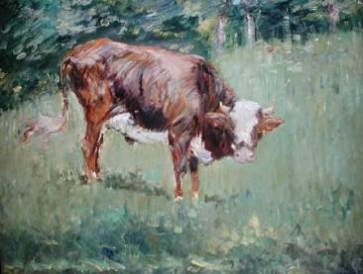
Aims
To provide you with the basic knowledge and skills to deliver teaching effectively
Using basic life support as an example of,
short,
skills acquisition,
training sessions
Notes:
Background information for trainers
Picture is by Edouard Manet. Young Steer in a Field. Wikimedia, marked for re-use.

Slide 4
Objectives for the day – 1
By the end of the day, you will be able to:
Set up and manage an effective educational environment
for teaching purposes, including clinical settings
Write clear and appropriate objectives for a teaching session
reflecting the learning needs of participants (including patients/relatives)
Design and use a teaching session plan
Understand how to use of a range of presentation styles and teaching aids
and when to incorporate these into a teaching session
Notes:
Emphasise
These objectives / learning outcomes are taken directly from the Foundation Programme curriculum
Background Information for trainers
A lot of authors would now use the term ‘learning outcomes’ here rather than ‘objectives’. See for example the overview at https://academicdevelopment.qmul.ac.uk/wp-content/uploads/2014/05/Aims-and-Outcomes-Guide.pdf. The ‘objectives’ described here are phrased as learning outcomes, but we have retained the term objectives for consistency with other Deanery teaching materials.

Slide 5
Objectives for the day - 2
By the end of the day, you will be able to:
Describe the advantages and disadvantages of large and small group teaching
and identify how to maximise interaction and learning in both
Describe how to facilitate group discussion
to allow those participating to express their views
Summarise how to give and receive feedback
in a structured, sensitive, constructive and positive way and perform skills and knowledge assessments
Discuss good practice in teaching and learning evaluation
and plan and undertake an evaluation of a teaching session

Slide 6
Programme for the day
09.30 COURSE START
Aims and objectives for the day
Introductions
10.00 Session 1 - What makes good teaching?
A-Z of good teaching
10.45 COFFEE
11.15 Session 2 - Large and small group teaching
Theory and practice
12.30 LUNCH
13.00 Review of morning and introduction to the afternoon
13.10 Session 3 – Teaching practical skills
Feedback - approaches and techniques
Practising with CPR based training
15.00 TEA
15.20 Session 4 - Managing Teaching
Managing the challenging participant
Evaluation of teaching
16.20 Final plenary review and concluding comments
16.30 CLOSE

Slide 7
Introductions
For 2 minutes on your own think about how confident you feel about teaching and why.
Rate your confidence:
Not confident at all
Not very confident
Neither confident nor unconfident
Quite confident
Very confident
Notes:
Introductory activity
Ask course participants to reflect on their confidence in teaching. Give 2 minutes for them to write down where they are and why. Go round the room asking everyone to introduce themselves and explain their confidence in teaching.
This can work well with a ‘Think, Pair, Share approach’. Each participant studies the slide for a minute on their own and reflects on their own position, then pairs up with another participant to discuss for about 2 minutes, then feeds back to the whole group.
This tends to work well as an ice-breaker and brings out that there is a range of confidence and ability but that most people do not feel very confident.
Note that with a large group this can be time-consuming.
Repeat at the end (there is another slide as a prompt) and ask for a percentage increase in confidence.
If organisers are familiar with the chair game this can be used instead / as well, but don’t forget to ask about confidence as above – this is part of our evaluation.
The picture is by Edvard Munch - Google Art Project, Public Domain, https://commons.wikimedia.org/w/index.php?curid=37624942

Slide 8
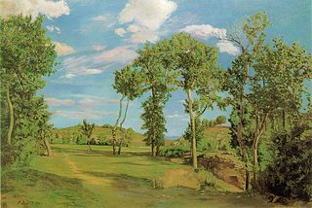
Ground rules
Time
Confidentiality
Respect
Questions
Mobile Phone/ bleeps off or silent
Anything else?
Notes:
Inform the participants
Time – we will finish by 16.30 – no matter what. Please be back promptly from coffee, lunch, tea at the times suggested by trainers
Confidentiality as real issues may come up
Respect – again real issues may come up
Questions as anyone thinks of them, don’t wait
Mobile phones etc. Self-evident. Anyone checking their messages / email during the teaching will be dealt with according to the most extreme penalties of the law! See for example The Mikado.
Background Information for trainers
Image is of ‘ground’ - well arguably. Frédéric Bazille, Paysage au bord du Lez, 1870, Minneapolis Institute of Art, copied from Wikipedia – and is in the public domain.

Slide 9
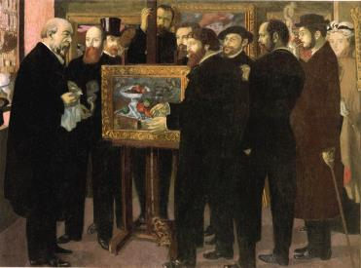
1. The A to Z of good teaching
Recall some examples of good teaching:
A | N
B | O
C | P
D | Q
E | R
F | S
G | T
….. | …..
Notes:
Set up a flip chart with the letters A to Z in two columns
Ask participants to generate examples of good teaching for each letter. E.g. E = Enthusiasm of teacher, S = good Slides. Accept all examples no matter how fanciful e.g. X=Xylophone.
Record answers using one colour for those ideas that reflect environment (e.g. good teaching aids) and another that reflect dialogue (i.e. the influence of the teacher). (Usually the teacher will turn out to be by far the most important factor)
Ask the participants if they can see what the different colours represent
Use the completed flipchart to emphasise that teaching is more than a mechanical process following rules (although there are rules – the rest of the day) but that the enthusiasm and clarity today’s participants (future teachers) bring to teaching will be key.
Additional possibility
With more than one group set this up as a competition – first to finish or maximum in 3 minutes
Background Information for trainers
The image is Homage to Cezanne by Maurice Denis - http://www.wikiart.org/en/maurice-denis/homage-to-cezanne-1900, Public Domain, https://commons.wikimedia.org/w/index.php?curid=33448549

Slide 10

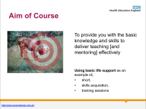
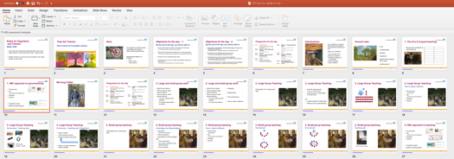

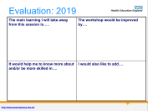
1. ABC approach to good teaching
Environment
Set
  Learning Aims and Objectives
Dialogue
Closure
Evaluation (later)
Makes a teaching plan!
Notes:
This teaching day can be used as an example: It comprises:
Environment
Detailed instructions for pre-course preparation and setting up the room are included in the Notes section of the introductory slide
Set - Aims and Objectives
We have 1 slide for a broad aim and 2 slides for detailed objectives (aka Learning Outcomes)
Dialogue
The day is structured around the PowerPoint set, but the Notes sections of the slides also structure the activities during the day.
Closure
We have a specific slide for this – not just ‘Any Questions’. This is commonly the bit people miss.
A previous participant suggested Every Student Deserves Coffee as an aide-memoire
Evaluation
Will be discussed later in the day
Teaching plan
Pulling all this together produces a teaching plan

Slide 11
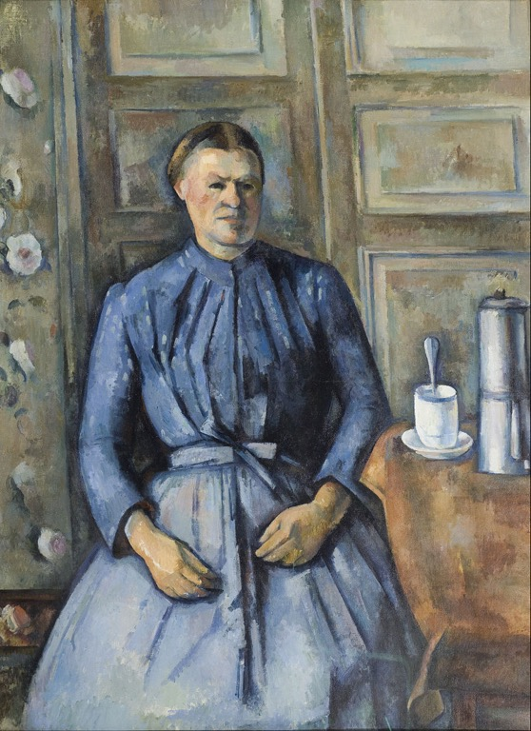
Morning Coffee
Notes:
Picture is Paul Cézanne - Woman with a Coffeepot. Taken from Wikimedia and labelled for re-use.

Slide 12
Programme for the day
09.30 COURSE START
Aims and objectives for the day
Introductions
10.00 Session 1 - What makes good teaching?
A-Z of good teaching
10.45 COFFEE
11.15 Session 2 - Large and small group teaching
Theory and practice
12.30 LUNCH
13.00 Review of morning and introduction to the afternoon
13.10 Session 3 – Teaching practical skills
Feedback - approaches and techniques
Practising with CPR based training
15.00 TEA
15.20 Session 4 - Managing Teaching
Managing the challenging participant
Evaluation of teaching
16.20 Final plenary review and concluding comments
16.30 CLOSE

Slide 13
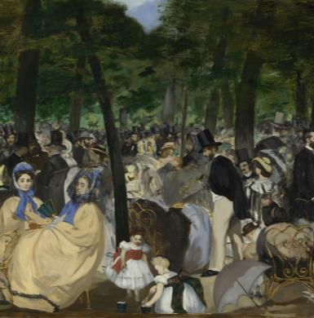
2. Large and small group work
Split into two teams
One to work on large group teaching
One to work on small group teaching
  15 min to discuss and prepare
  5 minutes presentation by group
Notes:
Explain that the participants will divide into two equal groups: one group will be looking at small group learning whilst the other group will be learning about large group learning. Each group will reflect on their own experiences of their respective teaching type and then presenting their learning to the other group in a 5 minute session.
Background Information for trainers
Image is Edouard Manet Music in the Tuileries 1862 taken from Wikimedia
For large groups (?>15/16) it may be worth splitting into three groups, with the third group preparing a presentation on either “ward-based teaching”, “skills teaching” or “simulation teaching.” Time will need to be allowed for this

Slide 14
2. Large and small group work
Split into two teams
One to work on large group teaching
One to work on small group teaching
  15 min to discuss and prepare
  5 minutes to present
Strengths
Weaknesses
Own experiences
How to make it effective
Notes:
Collect a flipchart to collect Strengths, Weaknesses and How to make it effective, do not reject any ideas (brainstorming rules) at this stage.
Review the flipcharts in the context of the next several slides (before the Lunch slide) to quickly review and give some structure to the ideas the participants have produced, picking up and discussing any areas of agreement or discrepancy between the participants’ presentations and the ideas on these slides. This should take no more than 15 minutes

Slide 15
2. Large Group Teaching
Presentation from large group team
Notes:
Show this slide briefly then blank it during the large group presentation
Background information for trainers
Image is Edouard Manet Music in the Tuileries 1862 taken from Wikimedia

Slide 16
2. Large Group Teaching
Good for large groups
  How small / large? Discuss
Large amount of information in a short time
but
Limited transfer of information
Difficult to test understanding
Notes:
Background information for trainers
Image is Edouard Manet Music in the Tuileries 1862 taken from Wikimedia

Slide 17
2. Large Group Teaching
Notes:
The arrows represent direction of information flow
Background Information for trainers
Image is Edouard Manet Music in the Tuileries 1862 taken from Wikimedia
Slide content is taken from the EPM Instructor course

Slide 18
2. Large Group Teaching
How to make it effective:
Environment
Teaching aids
Set
Learning Aims and Objectives
Dialogue
Closure
Notes:
Background information for trainers
Image is Edouard Manet Music in the Tuileries 1862 taken from Wikimedia

Slide 19


2. Large Group Teaching
Environment - Teaching aids:
If it can go wrong – it will!
By ChrisEngelsma - Own work, CC BY-SA 3.0, https://commons.wikimedia.org/w/index.php?curid=15740459
Notes:
PowerPoint (death by PowerPoint)
Laptop / MacBook
Memory stick
Cables
Microphone (By ChrisEngelsma - Own work, CC BY-SA 3.0, https://commons.wikimedia.org/w/index.php?curid=15740459)
Can make the point here that pictures need to be in the public domain or labelled for re-use and attributed
So need multiple redundancy and contingency plans – see the Notes section of the Introduction slide for this teaching session
Background information for trainers
Image is Edouard Manet Music in the Tuileries 1862 taken from Wikimedia
Other images taken from Wikipedia

Slide 20
2. Large Group Teaching
Environment - Teaching aids: PowerPoint:
Keep it simple
Text provides structure
Pictures reinforce structure
Break it up with interaction where possible
Notes:
Some examples:
Kawasaki’s 10 / 20 /30 rules (2005)
No more than 10 slides
No longer than 20 minutes
No font smaller than 30
We have broken all of these rules today! Arguably because teaching health professionals has more elements of imparting structure of knowledge whereas TED talks or Steve Jobs (see below) are more big-picture and conceptual – a possible discussion if time allows
See Steve Jobs presentation at MacWorld 2007: https://www.youtube.com/watch?v=P-a_R6ewrmM or any TED talk for good examples,
Background information for trainers
Image is Edouard Manet Music in the Tuileries 1862 taken from Wikimedia

Slide 21
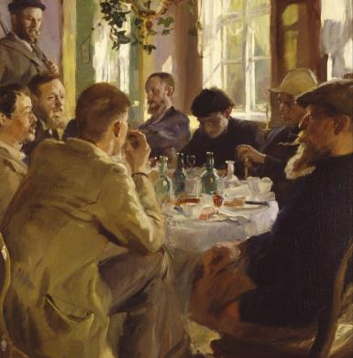
2. Small group teaching
Presentation from small group team
Notes:
Show this slide briefly and then blank it during the small group team presentation
Background information for trainers
Image is P.S. Krøyer: Artists at Lunch (1883) from Wikipedia

Slide 22
2. Small group teaching
Advantages and disadvantages:
Interactive
  Encourages participation
  Allows questions
  Applicable to clinical settings
But
  Time consuming
  Can cause confusion if not well-structured
  Less controlled
Notes:
Background information for trainers
Image is P.S. Krøyer: Artists at Lunch (1883) from Wikipedia

Slide 23
2. Small group teaching
How to make it effective:
Environment
Teaching aids
Set
Learning Aims and Objectives
Dialogue
Closure
Notes:
Background information for trainers
Image is P.S. Krøyer: Artists at Lunch (1883) from Wikipedia

Slide 24
2. Small group teaching
Environment
Or
Notes:
Split into pairs, 2 minutes on advantages and disadvantages of each layout. Gather ideas on a flipchart (2 minutes)
Background information for Trainers
Image is P.S. Krøyer: Artists at Lunch (1883) from Wikipedia

Slide 25
2. Small group teaching
Environment
Notes:
Layout 1 is more controlled
Layout 2 encourages interaction (teacher is more one of the group), but note that the participants on either side of the teacher have been unintentionally excluded
Background information for Trainers
Image is P.S. Krøyer: Artists at Lunch (1883) from Wikipedia

Slide 26
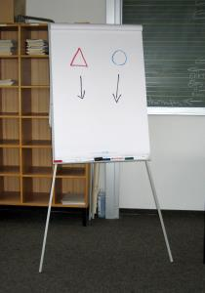
2. Small group teaching
Teaching aids
Much less to go wrong!
Notes:
Background information for Trainers
Image is P.S. Krøyer: Artists at Lunch (1883) from Wikipedia
Flipchart image is from Wikipedia

Slide 27
2. ABC approach to teaching
Environment
Set
  Learning Aims and Objectives
Dialogue
Closure
Evaluation (later)
Makes a teaching plan!
Notes:
Introduce the ESDC model as a model for planning a session. Encourage them to use it for next exercise.
This teaching day can be used as an example: It comprises:
Environment
Detailed instructions for pre-course preparation and setting up the room are included in the Notes section of the introductory slide
Set - Aims and Objectives
We have 1 slide for a broad aim and 2 slides for detailed objectives (aka Learning Outcomes)
Dialogue
The day is structured around the PowerPoint set, but the Notes sections of the slides also structure the activities during the day.
Closure
We have a specific slide for this – not just ‘Any Questions’. This is commonly the bit people miss.
A previous participant suggested Every Student Deserves Coffee as an aide-memoire
Evaluation
Will be discussed later in the day
Teaching plan
Pulling all this together produces a teaching plan

Slide 28
2. Teaching planning
In the same groups plan a session (ESDC) on a topic of your choosing.
The “large group” should prepare and deliver a small group session
The “small group” should prepare and deliver their topic as a large group session
Notes:
Split into two groups and ask one to prep and deliver something (anything) – but it should be delivered as a small group session.
The second group should deliver something as a large group session.
If there are three groups, we recommend dividing the groups slightly unevenly (e.g. 6,6,9) – with the largest group prepping something to give to the whole group as a large session, whilst the other two prep something to deliver as a small session. Each group delivers to half of the larger group (at different ends of the room)
Previous examples included;
How to pop up on a surfboard
How to moonwalk
Rules of rugby
Things to do in the southwest
There should be a short, facilitator led, feedback at the end of each sessiojn

Slide 29
Lunch
Notes:
Background information for trainers
The picture is Monet. Still Life with Grapes 1880. On Wikimedia commons and labelled for re-use.

Slide 30
Programme for the day
09.30 COURSE START
Aims and objectives for the day
Introductions
10.00 Session 1 - What makes good teaching?
A-Z of good teaching
10.45 COFFEE
11.15 Session 2 - Large and small group teaching
Theory and practice
12.30 LUNCH
13.00 Review of morning and introduction to the afternoon
13.10 Session 3 – Teaching practical skills
Feedback - approaches and techniques
Practising with CPR based training
15.00 TEA
15.20 Session 4 - Managing Teaching
Managing the challenging participant
Evaluation of teaching
16.20 Final plenary review and concluding comments
16.30 CLOSE

Slide 31
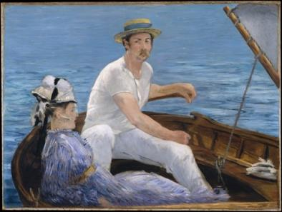
3. Using questions
Dialogue – using questions
In 60 seconds find out as much as you can about your neighbour’s last holiday.
Use only open questions.
(Why?, How?, Tell me more about...)
Notes:
This is a nice ice breaker and after having a go can discuss open versus closed and when both are used. We find that most medics think they use mostly open questions at work, but often most questions we use in clinical practice are closed.
Practise open and closed questions – this should be a very quick activity.
Background Information for trainers
Image is taken from Wikimedia

Slide 32
3. Using questions
Dialogue – using questions
In 60 seconds find out as much as you can about your neighbour’s last holiday.
Use only open questions.
Change Roles
In 60 seconds find out as much as you can about your neighbour’s last holiday.
Use only closed questions.
(Closed questions expect yes, no or short answers)
Notes:
Practise closed and open questions – this should be a very quick activity.

Slide 33
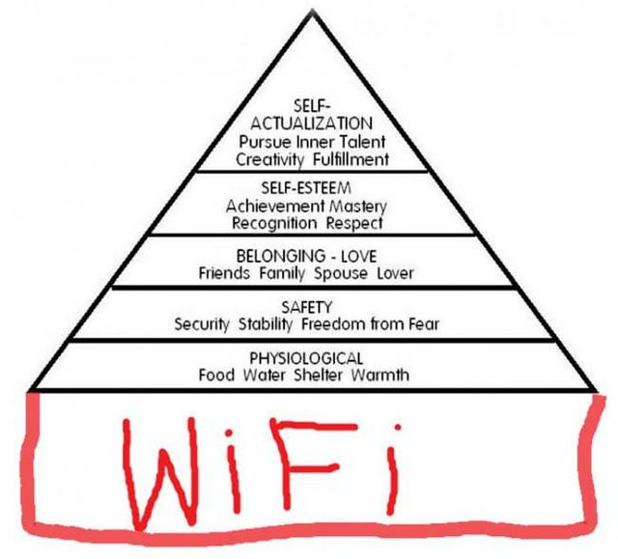
3. Teaching practical skills - Maslow’s hierarchy of needs
?
Notes:
Use this slide to encourage participants to come up with their own ideas for relevance before showing the next one
Background Information for trainers
A. H. Maslow. A Theory of Human Motivation. (1943) Psychological Review, 50, 370-396.
Image is from FlickR

Slide 34
3. Teaching practical skills - Maslow’s hierarchy of needs
Environment
  Heating
  Lighting
Coffee breaks
Toilets
Fire evacuation instructions
Friendly atmosphere
Learning something
Notes:
Background Information for trainers
A. H. Maslow. A Theory of Human Motivation. (1943) Psychological Review, 50, 370-396.
Image is from FlickR

Slide 35
3. Teaching practical skills - theory
Child learning - pedagogy
  Children:
  Dependent on the instructor
  Bring little experience to the teaching
  Are told what they have to learn
  Primarily motivated by external pressures
Notes:
Theory - whole group (20 minutes)
Adult learning theories and cycles
Types of teaching
Skills learning and competencies
Background information for trainers
Image is Camille Pissaro. Children in the Garden 1887
Knowles, M. (1984). The Adult Learner: A Neglected Species (3rd Ed.). Houston, TX: Gulf Publishing.
Knowles, M. (1984). Andragogy in Action. San Francisco: Jossey-Bass.

Slide 36
3. Teaching practical skills - theory
Adult learning - andragogy
  Adults like:
  Involvement
  Relevance
  Interaction
  Focus on a problem or skill
Notes:
Explain that most of the teaching participants have experienced in the last few years has been andragogy (hopefully) although some Medical School teaching might be veering towards pedagogy (previous slide). Teaching CPR to schoolchildren may fall between the two.
Theory - whole group (20 minutes)
Adult learning theories and cycles
Types of teaching
Skills learning and competencies
Different from child learning - pedagogy
This is why learning a curriculum can be irritating for adults
Background information for trainers
Knowles, M. (1984). The Adult Learner: A Neglected Species (3rd Ed.). Houston, TX: Gulf Publishing.
Knowles, M. (1984). Andragogy in Action. San Francisco: Jossey-Bass.

Slide 37
3. Teaching practical skills
Theory – learning styles
Competing and contested theories
Pask
Serialist
Holist
VARK
Visual
Auditory
Reading / writing
Kinesthetic
Little theoretical underpinning
Not consistent attributes
No evidence that using learning styles improves outcomes
But still popular
Honey and Mumford
Activist
      open to new experiences, sociable, egocentric, impulsive
    Reflector
  cautious observer rather than participant
Theorist
  logical and rational
Pragmatist
  practical
Notes:
Background information for trainers
Honey, P. and Mumford, A. (1986) Using your learning styles. Maidenhead
Pask, G. (1976) Styles and strategies of learning. British Journal of Educational Psychology, 46 128-48
VARK is the most common system in current use – often cut down to VAK
See https://www.britishcouncil.org/voices-magazine/four-reasons-avoid-learning-styles-one-alternative
Much more useful is Kolb’s learning cycle – next slide

Slide 38
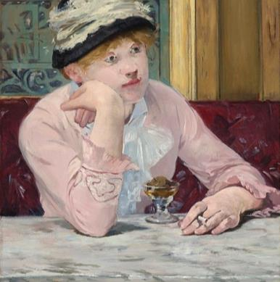
3. Teaching practical skills
Theory – Kolb’s Learning Cycle
Experience
Try it
Plan
What to do the same / differently next time
Reflect
What went well?
Conceptualize
Generalize
Notes:
Individuals may like to start at different points, but it important to complete the full cycle.
Hence the importance given to reflection in e-portfolios

Slide 39
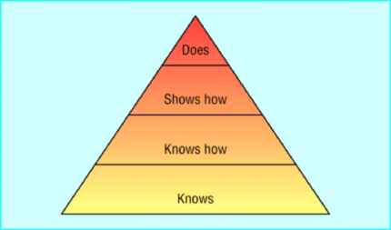
3. Teaching practical skills
Theory - competencies
Knowledge
Skills
Behaviours
ARCP
Annual Review of Competency Progression
Miller’s Pyramid
Notes:
Background Information for trainers
Miller, G.E. (1990). The assessment of clinical skills / competence / performance. Academic Medicine, 65, (9), S63-67.

Slide 40
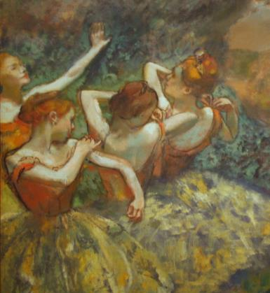
3. Teaching practical skills
Theory - The Four Stage Approach
    Demonstration
        Silent run through in which teacher performs without commentary
    Deconstruction
      Teacher then performs while commentating
      Teacher then performs with commentary from student(s)
    Formulation
      Finally student performs and commentates
Notes:
‘Silent’ here means without commentary. It may be better thought of as ‘real-time’ run-through, particularly since in BLS it is key to Shout for Help.
Background Information for trainers
Image is: Four dancers on a Stage by Degas. Taken from Wikimedia Commons

Slide 41

3. Practice with BLS
4 groups
2 groups with each trainer
Each group to attempt one topic
Role play ‘teacher’ and ‘learner’
‘Teacher’ uses 4 stage technique
2 or 3 rounds
Notes:
Don’t worry about feedback yet – that is coming up next
Separate in to 4 groups with two assigned to each trainer. Each group to attempt one of the following topics each participant in turn having a practice with helpful feedback from other participants: (30 minutes)
The initial approach in CPR
Chest compressions
Head tilt chin lift
Placing a patient in the recovery position
(all of these can be done without a manikin, with one of the group being the manikin – except for chest compressions!)
Demo by each group with summary of learning about doing it (20 minutes)

Slide 42
3. Practical skills – individual feedback
Theory - feedback
In groups of 3 or 4 discuss and prepare to report on:
Why give feedback
5 minutes
How to give feedback
5 minutes
Notes:
Put the participants in groups of 3 to discuss:
Why give feedback (5 minutes) and
How to give feedback (5 minutes)
This activity could be made longer or shorter depending on how the day has gone.
Collate the results on a flip chart
Then move on to the next slides to pick up anything that has been missed. Participants are unlikely to know the SOME-TLC framework
Background information for Trainers
The picture is The Balcony (Le Balcon) by Édouard Manet, currently in the Musée d'Orsay, Paris

Slide 43
3. Practical skills – individual feedback
Theory – feedback. Why
Motivator
for achieving goals, influence behaviour, to improve performance.
Reinforcing
be specific about what you like, why you like it and the impact it has on you/others/outcomes.
Developmental
to change outcome, goal achievement.

Slide 44
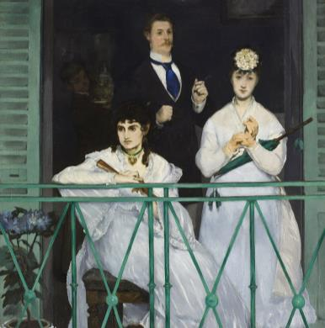
3. Practical skills – individual feedback
Theory – feedback. How - More Principles
Individual
Be conscious of tone and use ‘I’ statements …….’I feel you would…’
Focus on actions, not on the person and use positive language
Give specific examples and suggestions
Make it a conversation for the other person to suggest how they might change
Notes:
Other feedback considerations
Individual
Conscious of tone
Use I statements …….I feel you would…….(not the accusatory you)
Focus on actions, not on the person. (stating that a person disorganized Vs a person could be more structured to achieve higher efficiency and outcomes)
Use positive language …. I would love to hear/see/observe you/ ..I would enjoy it if I heard/saw/observed….(doesn’t this sound better than you don’t speak up enough at meetings).
Give specific examples and suggestions. ‘Could you help me after lunch as I have been staying late recently. Rather than ‘ You never help me out so I’m always late’.
Does this feedback need to be given or does it need to be given by you? Does the person really need to be corrected.
Make it a conversation for the other person to suggest how they might change.

Slide 45
3. Practical skills – feedback
How - Actually doing it
Ask:
How do you think you did? What went well? Did you have any problems?
Tell:
I observed…It seemed as though…. When you do …. I feel….. Teach – Consider… In my experience
3. Ask learner to reflect and analyse:
What do you think of my… observations, my comments… What would you do differently / to improve…
Act:
Summarise, demonstrate, re-assess, commit to a plan. i.e Act has an outcome which is agreed between two parties
Notes:
The old feedback sandwich (what you did well, what you did badly, what to improve) – isn’t very palatable. Use the new feedback sandwich in the slide
Trainers and participants are likely to be familiar with various versions of this from e.g. ALS courses. The key points are about objectivity and not letting strengths get lost in a flurry of ‘could do betters’. Equally the whole thing should carry an element of realism. Positive reframes may be useful: As an example: ‘There were a lot of good things in what you did’… ‘and now that we have had a first go some ideas on what to change…’.
Ask: how do you think you did, what went well, did you have any problems
Tell: I observed…It seemed as though…. When you do …. I feel….. Teach – consider…in my experience..
Ask learner to reflect and analyse… what do you think of my… observations, my comments… What would you do differently/ to improve
Act - summarise, demonstrate, re-assess, commit to a plan. i.e act has an outcome which is agreed between two parties.
(NOTE: this new sandwich technique replaces using the Pendleton rules which are an alternative. These are based on six key questions/input:
What were you aiming to achieve and how did you do?
Tell me what did you do well?
I think you did … well (with examples)
Tell me what you could do better?
I think you could … (with examples)
What are your specific improvement plans now after this feedback?)

Slide 46
3. Practical skills – individual feedback
Theory – feedback
How – Principles: SOME-TLC
Specific
Goal referenced
Objective
Non judgemental
Modifiable behaviour
Tangible and actionable
Expected
Timely
and in the correct location
Limited
Constructive
Notes:
This is a model for giving effective feedback – it may be useful to introduce

Slide 47
3. Practice with BLS
4 groups
2 groups with each trainer
Each group to attempt one topic
Role play ‘teacher’ and ‘learner’
‘Teacher’ uses 4 stage technique
  Just perform stage 4 this time (i.e. learner attempts)
‘Teacher’ gives ’learner’ feedback
Group gives ‘teacher’ feedback
Repeat
(30 minutes)
Notes:
What we have done for this is a bit of roleplay, which works really well.
The group will already have practiced the four stage approach, so this time is just about practicing stage 4 (i.e. the learner has a go) and then giving feedback,
We prepare some “roles” and give them out to each learner. Ideally the group should be divided into fives and then each member is given one role (to keep secret). Our suggestions, based on the common “difficult candidates” are;
The poor learner with some insight – performs poorly, but understands. Will need some constructive feedback
Disinterested – does ok but is not really engaging, probably is “very experienced” and feels exercise is below them. Can’t see the point, not really engaging with feedback
Anxious / catastrophising learner who performs well – does ok but thinks did/is awful. May get upset
Nervous – very nervous and reluctant and get going. Teacher may need to intervene and guide them through
Poor learner who lacks insight – this is hardest one probably. Performs poorly/does things wrong but thinks did really well, reluctant to accept feedback
It may be worth prepping a short summary of the role of each candidate
Separate in to 4 groups with two assigned to each trainer. Each group to attempt one of the following topics each participant in turn having a practice with helpful feedback from other participants: (30 minutes)
The initial approach in CPR
Chest compressions
Head tilt chin lift
Placing a patient in the recovery position
Demo by each group with summary of learning about doing it (20 minutes)

Slide 48
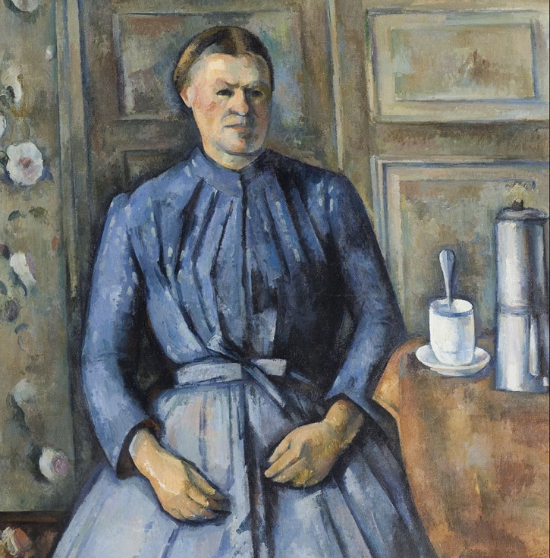
Afternoon Tea

Slide 49
Programme for the day
09.30 COURSE START
Aims and objectives for the day
Introductions
10.00 Session 1 - What makes good teaching?
A-Z of good teaching
10.45 COFFEE
11.15 Session 2 - Large and small group teaching
Theory and practice
12.30 LUNCH
13.00 Review of morning and introduction to the afternoon
13.10 Session 3 – Teaching practical skills
Feedback - approaches and techniques
Practising with CPR based training
15.00 TEA
15.20 Session 4 - Managing Teaching
Managing the challenging participant
Evaluation of teaching
16.20 Final plenary review and concluding comments
16.30 CLOSE

Slide 50
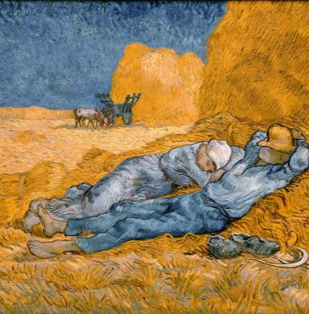
4. Managing learning
The Challenging Candidate
What problems have you encountered
  Today!
  Previously?
Whole group
  discuss problems, solutions and report back
Notes:
This activity is planned to last 30 minutes, but in practice can be shorted or extended to ensure the day runs to time
This is best done as a large group facilitated discussion (e.g. in a circle) – the idea is to discuss how everyone got on with the last exercise/how to deal with such candidates in real life, but also clear up any other questions/issues from the day. It may be worth inviting students’ experiences and questions relating to good/poor teaching they have experienced before and/or examples of difficult candidates (either in feedback or in group/lecture work). Essentially this is a group chat to clear up any issues/questions.
Examples
Be angry with someone or something
Keep being distracted
Take the discussion off the point several times
Agree with absolutely everything
Disagree with one person constantly
Really support one other person in the group
Talk loudly over other people
Ignore one person completely
Be completely batty and all over the place
Don’t take anything seriously
Disengage and be silent
Try to take over the leadership of the group
Introduce new topics
Be terribly serious about everything
Get up, walk around and sit again
Leave the group and return in a short period
Talk much about a pressing work issue or personal concern
Read a book or newspaper
Be very intense about the dynamics and processes in the group
Solutions
Verbal intervention (question, redirection, overhead comment etc);
Non-verbal intervention (indication, show concern etc) or
Process change (new topic, move on with session, take break, resort group etc)
Background information for trainers
Image is Vincent van Gogh Rest from work. Taken from Wikimedia Commons

Slide 51
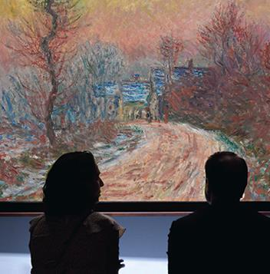
4. Managing learning
Assessment of an individual
Formative
  “to help identify strengths and weaknesses
  to modify training and practice
  in order to meet personal and professional goals”.
Summative
  Pass or fail
  Exams, ALS courses
Notes:
Now time to discuss how we evaluate our teaching – often best done with facilitator at front leading.
The terms appraisal, assessment and evaluation are used confusingly and non-uniformly.
Here we are using
Assessment as above
Appraisal (not discussed in this teaching) as an annual event – which may include elements of summative assessment (e.g. ARCP)
Evaluation – of a teaching or training event or a curriculum.
Formative assessment definition is from - General Medical Council (1998). The Early Years. London: GMC. p.10. This is an old document but is still the best definition I can find.

Slide 52
4. Managing learning
Evaluation of teaching or training
Quantitative and qualitative
Outcome focused (Kirkpatrick)
Linked to
  aims and objectives
  curriculum
  requirements of organization / funder

Slide 53
4. Managing learning
Evaluation - Kirkpatrick
Reaction
  Did participants find the training engaging and relevant?
Learning
  Did participants acquire competencies?
Behaviour
  Did participants apply what they learned to their job?
Results
  Did targeted outcomes occur?
Notes:
Evaluating a learning experience (15 minutes)
Kirkpatrick
In practice very difficult
Quantitative and qualitative ideal – but very time consuming so pragmatic approaches on the day:
Background Information for trainers
Kirkpatrick, D.L. (1959a). Techniques for evaluating training programs. Journal of the American Society for Training and Development, 13(11), 3-9.

Slide 54
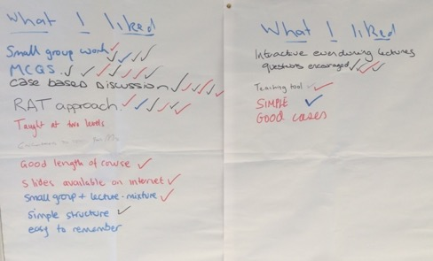
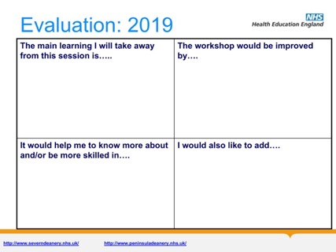
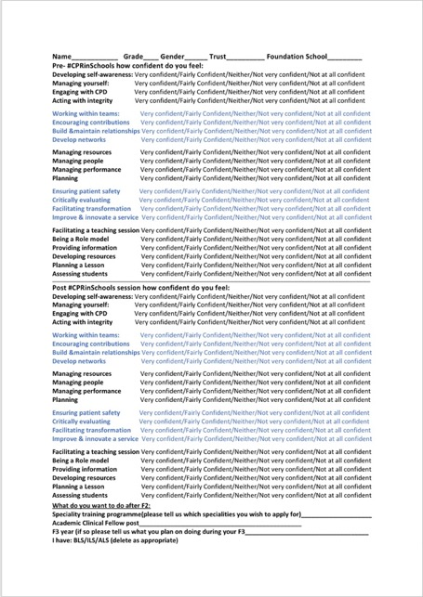
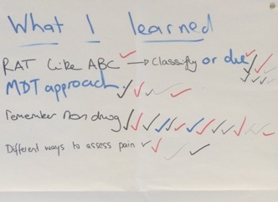
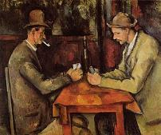
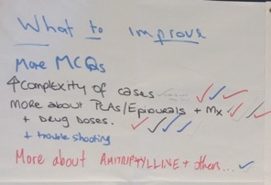
4. Managing learning
Evaluation – what level is each?
4.
3.
1.
2.
Notes:
We often do not do this exercise, but it can be added in
Give the participants a minute to work out what level each of these examples works at. Collect ideas from around the room.
Examples are (from top left)
A standard Severn Deanery evaluation sheet with lots of white space. Kirkpatrick level 1 – Reaction.
Two people having a discussion (for example a course teacher with an attendee or key stakeholder) – qualitative approach. Potentially Kirkpatrick level 4 - Results.
An AMEE form that was considered for this course – quantitative Likert scales, and limits replies – but easy to analyse. Kirkpatrick level 1.
A ‘Delphi Walls’ approach derived from a ‘Keep, Change, Chuck’ evaluation used by Alan Cook in Severn Deanery. All participants are allowed to right anything they want on 3 sheets entitled ‘What I liked’, What I learned’ and What to improve’. To agree with a comment that is already there participants put a tick next to it to, disagree they put a cross. This is used in the Essential Pain Medicine course both in the UK and globally. Kirkpatrick levels 1 and 2.
(Not shown – but MCQs before and after (e.g. ALS) would be Kirkpatrick level 2 – Learning)
Background information for trainers
The picture is Paul Cézanne (strictly speaking a post-impressionist), The Card Players, 1894–1895, Musée d'Orsay, Paris. Taken from Wikipedia and is in the public domain. It can be taken to refer to a course organiser.

Slide 55
Where to now?
  What you may do next or will happen after today
  Resources available for you in life support and other skills training
  Who is available for support and coaching
Notes:
What participants would like to do
ALS trainers
Support and coaching: ES, College Tutors, DME, Schools
Or
Just go with the picture and take up absinthe and smoking

Slide 56
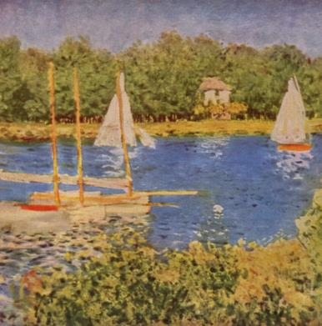
Reflection and review
  Concluding comments
  What have you learned matched against the objectives?
  Particularly useful techniques gained from the day?
  One action/skill you might try out as soon as possible?
Don’t forget to complete the online evaluation
Notes:
Feedback from groups of key learning points
Discussion of key lessons from the day:
It may be useful to go back to any Objectives the participants came up with for themselves at the start of the day, or the Objectives slides
Ask participants to complete evaluation and equality monitoring forms
Background information for trainers
Image is The Seine Basin at Argenteuil, Claude Monet 1873 . Taken from Wikimedia

Slide 57
Confidence
Rate your confidence:
Not confident at all
Not very confident
Neither confident nor unconfident
Quite confident
Very confident
How much (%) has your confidence changed?
Notes:
Also ask for a percentage increase in confidence.
If organisers are familiar with the chair game this can be used instead / as well, but don’t forget to ask about confidence as above – this is part of our evaluation.
The picture is by Edvard Munch - Google Art Project, Public Domain, https://commons.wikimedia.org/w/index.php?curid=37624942

Slide 58


End of course!
Notes:
Worth adding in a link to local CPR in schools/other educational oppurtunities

